Slide 1
Lecture 5: Transfer Functions and Block Diagrams
Review differential equation solution process
Transfer function models
Intro to block diagrams
Intro to time response analysis (if time)

Slide 2
Differential Equation Review
Recall, the Laplace transform converts LTI differential equations to algebraic equations
differential
equation
solve in time domain
x(t)
1
L
L⁻¹
3
algebraic
equation
solve in s-domain
X(s)
2

Slide 3
Differential Equation Review
Let’s determine the solution of the linear differential equation from last lecture
System has no damping, note that the roots of characteristic equation are purely imaginary
Can solve for θ(t) using the Laplace transform

Slide 4
Example

Slide 5
Example (continued)
The free response (f(t) = 0) is then
θ(t) is a shifted sinusoid of frequency ω_{n}, called the (undamped) natural frequency
Now consider mass-spring-damper example from last time (which does have damping)

Slide 6
Example

Slide 7
Example (continued)
y(t) is a damped sinusoid with frequency 6 rad/sec … called the damped natural freq ω_{d}
The (undamped) natural frequency ω_{n} is frequency if the system has no damping

Slide 8
Transfer Function Models
Often it is desired to remain in the Laplace domain for analysis and manipulation
The transfer function G(s) of a system is an alternative model to the differential equation and is defined as the ratio of the Laplace transform of the output Y(s) to the Laplace transform of the input U(s) assuming zero initial conditions

Slide 9
Transfer Function Models
Characterize the input-output relationship of a dynamic system (ignores initial conditions)
Are a property of the system itself, not specific to the particular forcing input (represent natural response)
Have units, but do not provide information concerning the physical structure
Apply only to linear time-invariant (LTI) systems
Make combining systems much easier

Slide 10
Finding a Transfer Function Model
Begin with
Choose what is the input and what is the output
Take Laplace transform assuming zero ICs
Rearrange

Slide 11
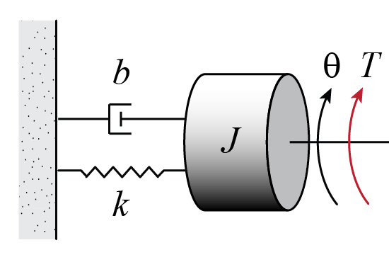
Example
Find the equation of motion for the following system

Slide 12
Example (continued)
Find the transfer function for the previous example where T(t) is the input and θ(t) is the output

Slide 13
Block Diagrams
is often drawn as a block diagram
where U(s), Y(s) are signals and G(s) is a system
Mathematically, Y(s) = G(s)U(s)
In the time domain, need a convolution integral
U(s)
Y(s)
G(s)

Slide 14
Block Diagrams
Useful for visualizing complex systems
wind force,
gravity force
+
Control
Algorithm
Engine
-
Car
desired
speed
-
throttle
angle
(voltage)
+
actual
speed
force
Speedometer
measured
speed

Slide 15
Block Diagrams
Useful for visualizing complex systems
here each block is a transfer function and the arrows represent signal flow
D
R
+
E_{m}
C(s)
G(s)
-
U
P(s)
Y
-
+
Y_{m}
H(s)
Notes:
Can get even more complicated than this … feedforward control … multiple feedback loops … other extraneous inputs like noise

Slide 16
Time Response
Consider the TF from our earlier example
It is desired to find the time response θ(t) for different torque inputs
In general,

Slide 17
Time Response
Impulse response –

Slide 18
MATLAB Notes

